Slide 1




HANDBOOK 2023

Slide 2
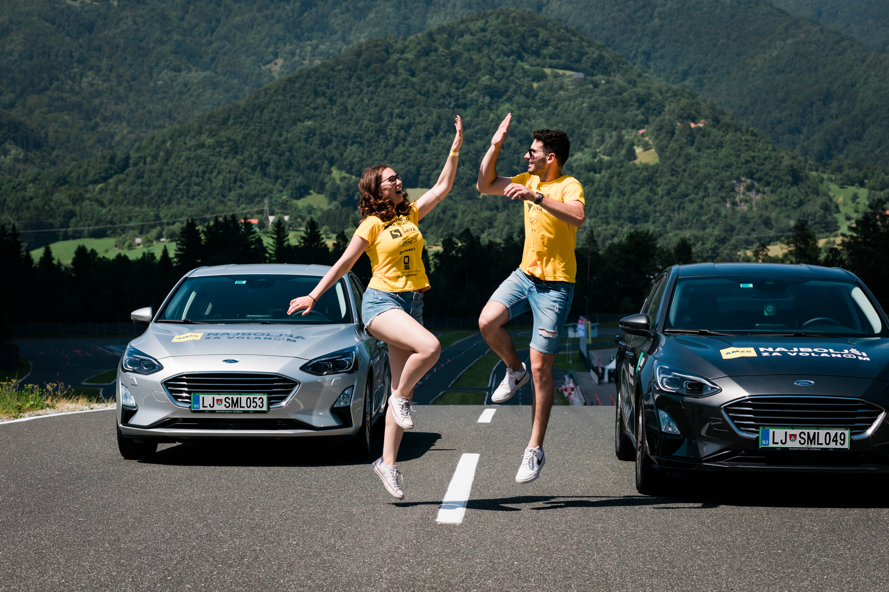
TABLE OF
CONTENTS
Agenda | 3
Host City | 4
Track | 5
Venue | 6
Hotel | 7
Transport | 8
Tasks | 9
Schedule | 16
Prize | 17
Contact | 18

Slide 3
Friday, 6.10.2023
Arrival of teams
18.00 – 18.30 Registration - Hotel Doppio
18.30 – 19.30 Presentation of the teams & Briefing of the competition, group draw - Hotel Doppio
20.00 Buffet dinner - Hotel Doppio
Saturday, 7.10.2023
07.00 Breakfast
08.00 Transfer to Teesdorf
09.00 Start - Competition
12.15 Lunch
13.15 Competition
15.30 Photo opportunity
15.45 Go Kart
17.00 Transfer to the hotel
19.00 Transfer to ÖAMTC headquarters for the Award Ceremony for the Award Ceremony ÖAMTC h
19.30 Award ceremony and dinner
22.00 Transfer to the hotel
Sunday, 8.10.2023
Departure of the contestants
#1 AGENDA

Slide 4
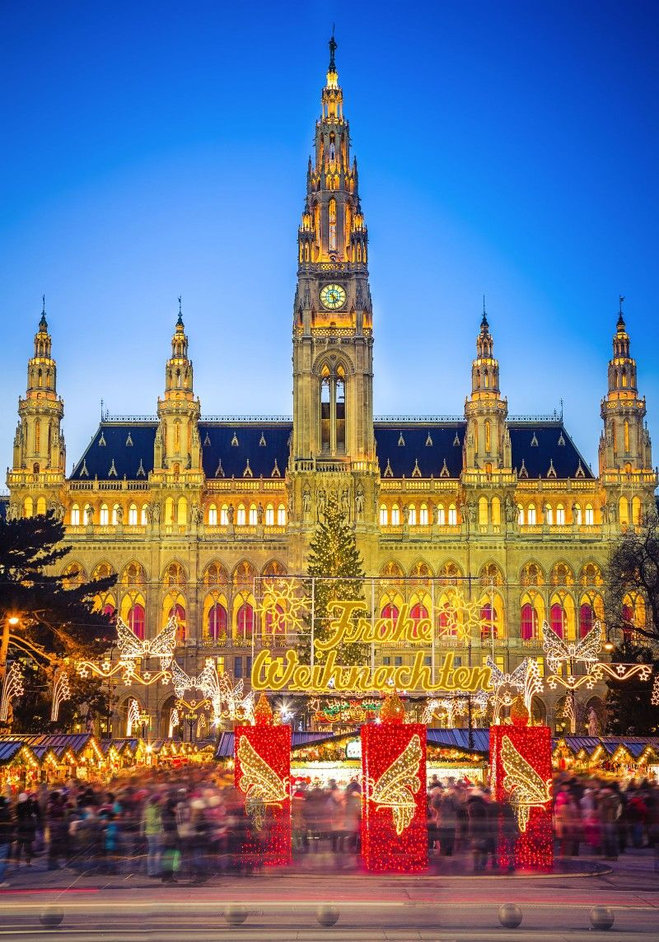
#2 HOST CITY
VIENNA, the capital of Austria, stands on the banks of the mighty Danube River, and is home to around 2 million people. Vienna gives the feel of a large town thanks to the numerous parks, woodlands, outlying hills, and other open and green spaces.
Vienna owes its size and much of its beauty to the legacy of the Habsburg monarchy that ruled over large areas of Europe for many centuries. As an imperial capital, Vienna has many monumental buildings thanks to various Emperors, Empresses, and their families who constantly appreciated the craftmanship in architecture.
Nowadays, one can still visit churches that date back over 1000 years or contemplate great works of art that fill Vienna’s museums in this beautiful and clean city that is packed with urban charm, rich and long history, plenty to see and do, excellent services and amenities, and a selection of cakes that will do evil things to your willpower.
Visit www.wien.info/en for more information on Vienna.

Slide 5
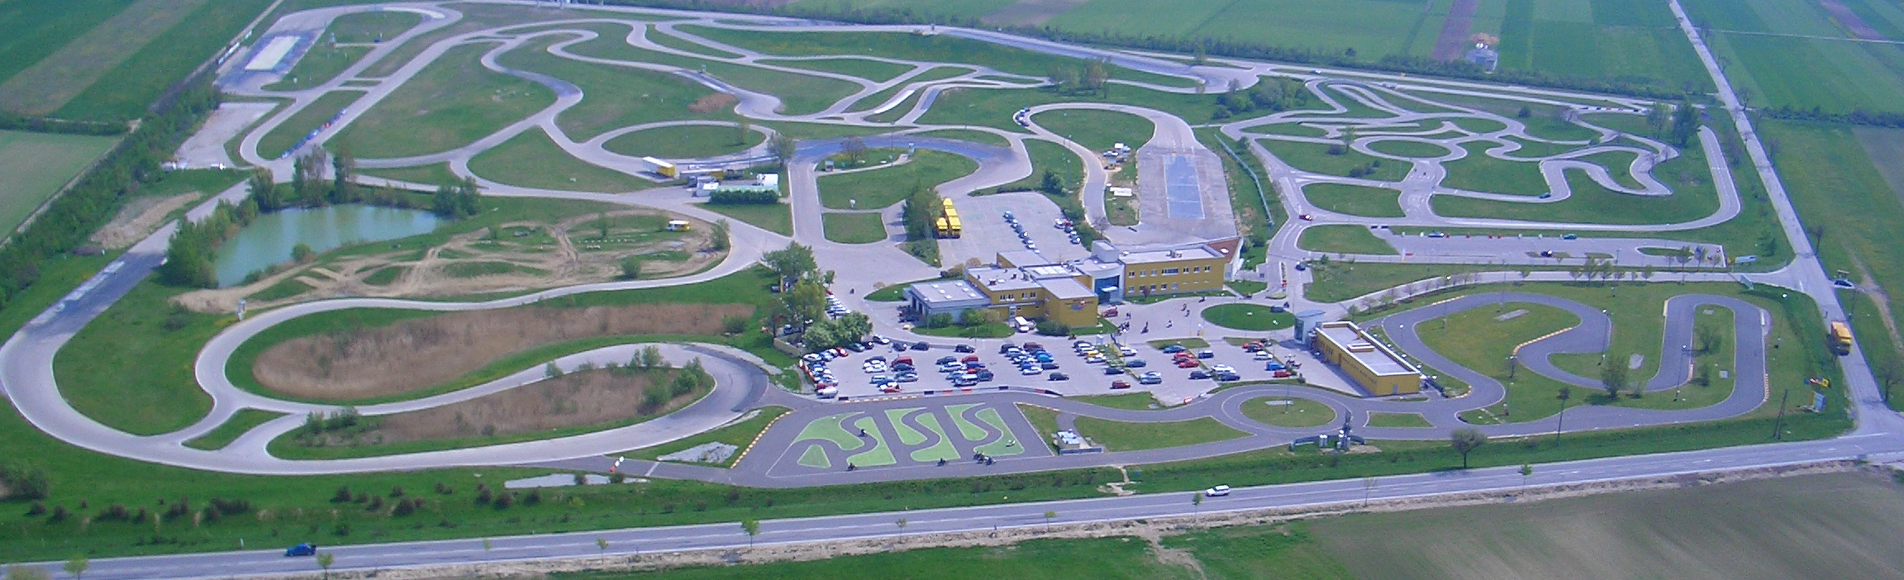
#3 TRACK
The Teesdorf Driving Technique Centre is about 25 kilometres from the southern outskirts of Vienna and is located near the city of Baden.
With an area of around 40 football pitches and its high-tech facilities, including 9 training tracks, off-road park, motorcycle center, event hall, traffic training area, outdoor go-kart track, the center is the leading facility in Europe.
Up to ten courses can be held at the same time. The special lighting system allows training even in the dark.
Address: Triester Bundesstraße 120, 2524 Teesdorf, Austria

Slide 6
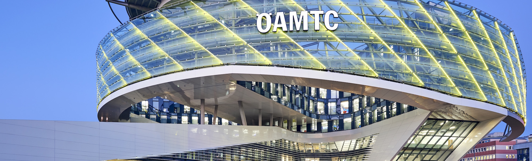
#4 VENUE
ÖAMTC The ÖAMTC Headquarters is an architectural highlight along the Vienna’s southeast freeway. The mobility centre boasts nine levels of offices, conference spaces and training facilities.
Address: Baumgasse 129, 1030, Vienna, Austria

Slide 7
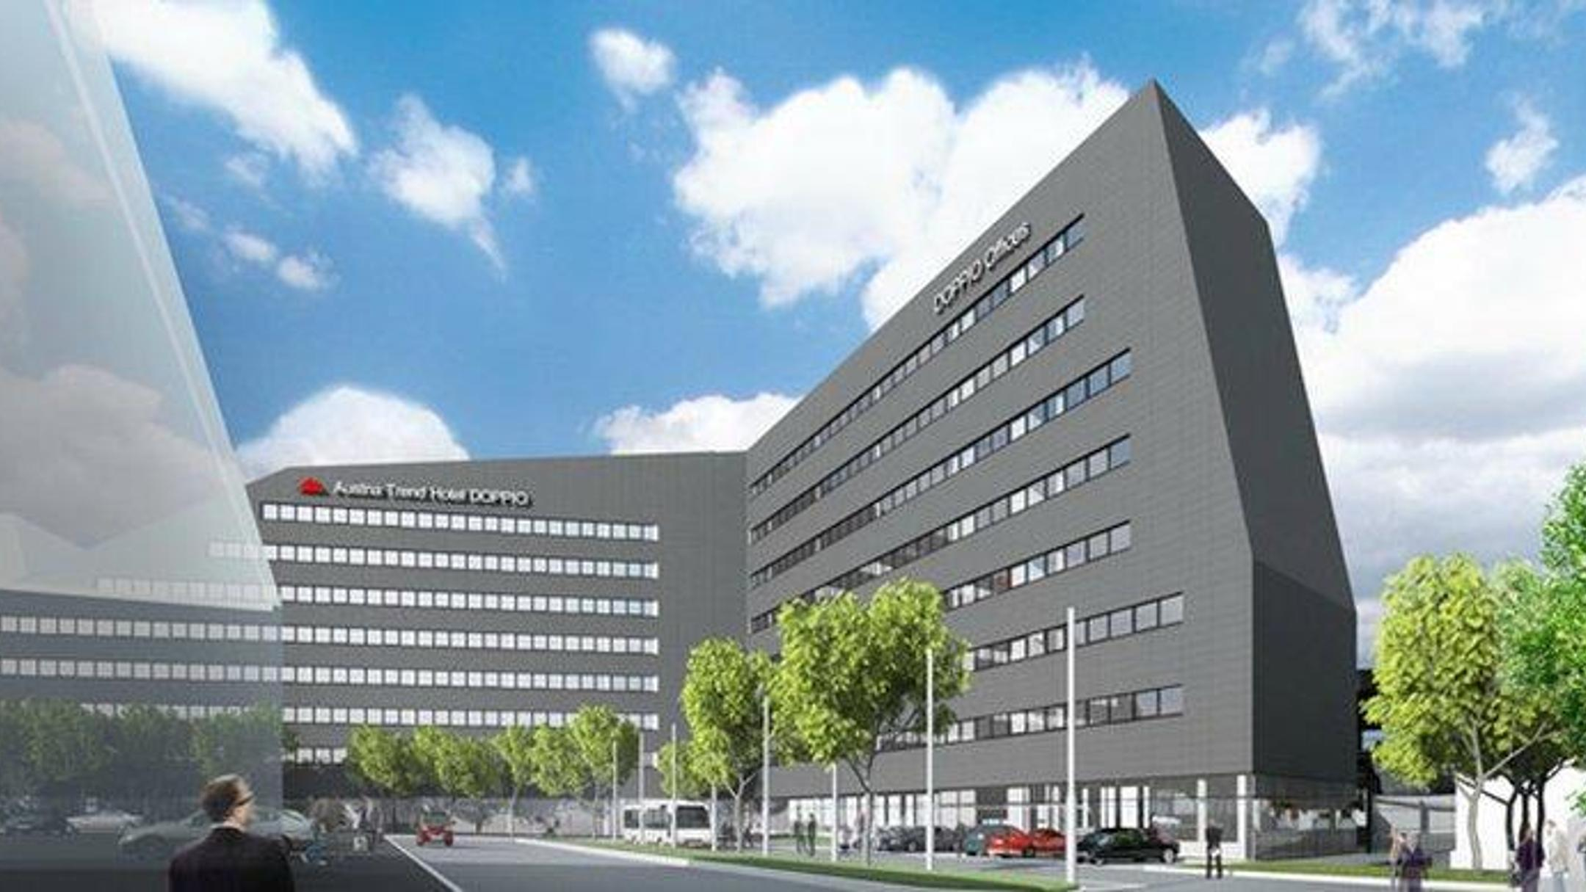
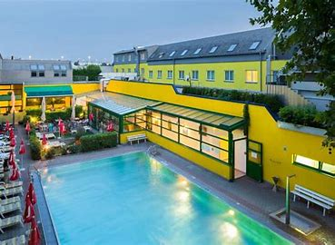
#5 HOTEL
HOTEL DOPPIO
Address: Rennweg 99/Rinnböckstraße 1, 1030 Vienna, Austria
Phone: (+43) 17 90 25 91 00
Email: doppio@austria-trend.at
Paid Parking: Available
SPORT HOTEL
Address: Baumgasse 83, 1030 Vienna, Austria
Phone: (+43) 17 98 8201-0
Email: info@vienna-sporthotel.at
Paid Parking: Available

Slide 8
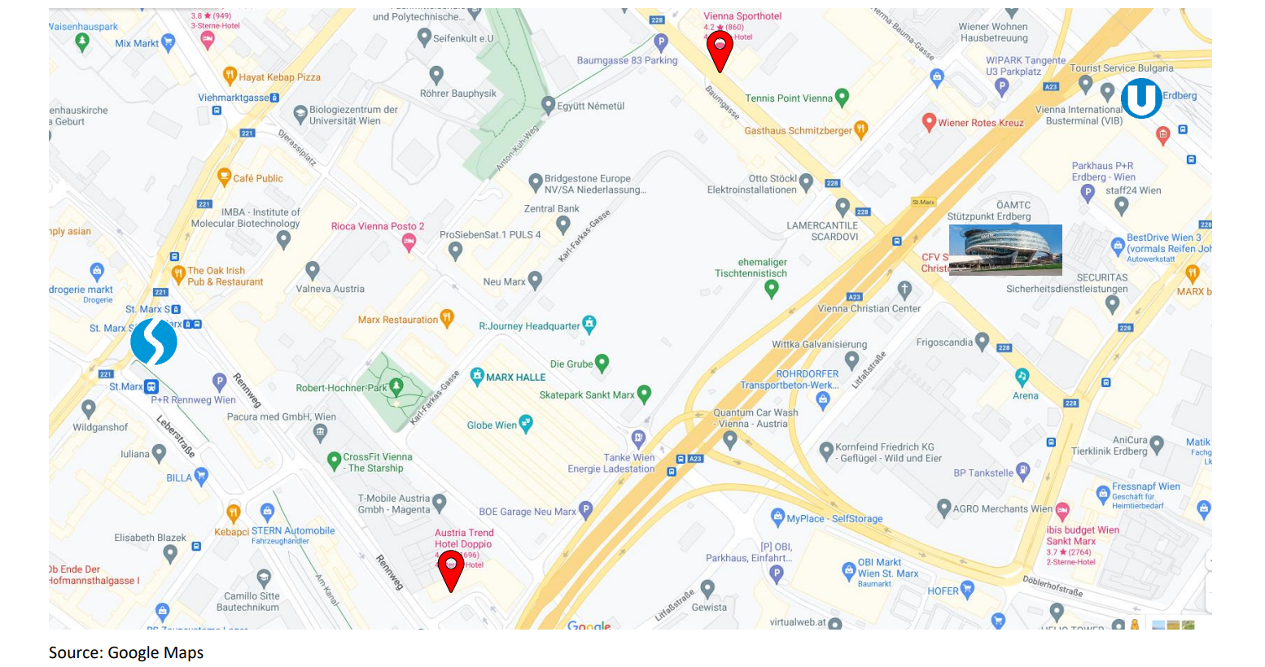
HOTEL – TEESDORF
  Group transfer (45 minutes) for participants and coaches will be organised by ÖAMTC.
AIPORT – HOTEL BY TAXI
  A taxi would cost around 50 EUR. If you order a transfer online the price is lower. Order a taxi here: www.airportdriver.at/de
AIPORT – HOTEL BY PUBLIC TRANSPORT
  Hotel Doppio: train S7 direction Floridsdorf to station Vienna Bio Center St. Marx, exit Landstraßer Hauptstraße – walk along the T-Mobile Building located right – after about 5 minutes walk turn left in front of car dealer Benda – the hotel is in front of you.
  Sport Hotel: train S7 direction Floridsdorf to station Wien Mitte, then metro U3 till station Schlachthausgasse, subway exit Markhofgasse.
#6 TRANSPORT

Slide 9
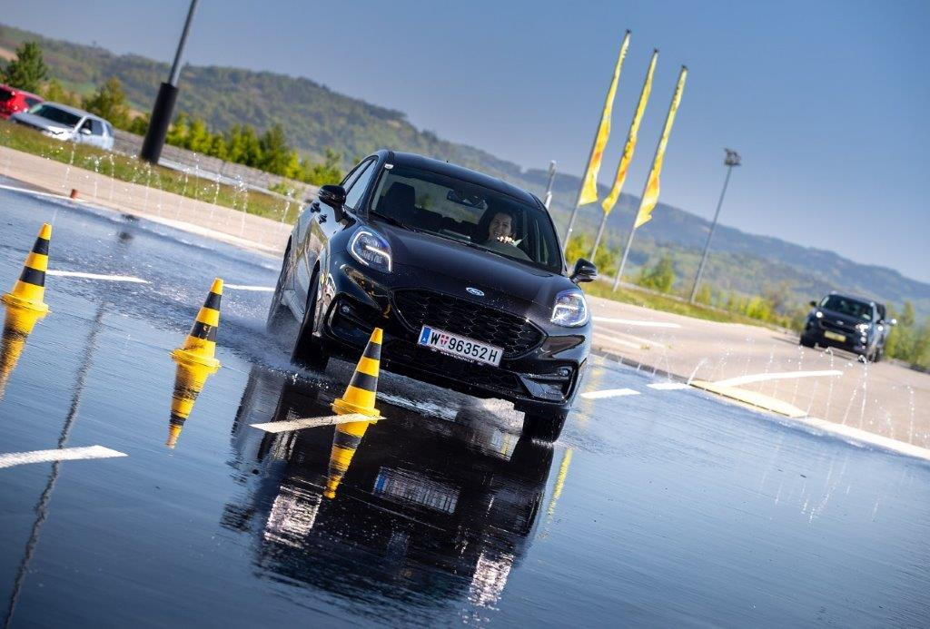
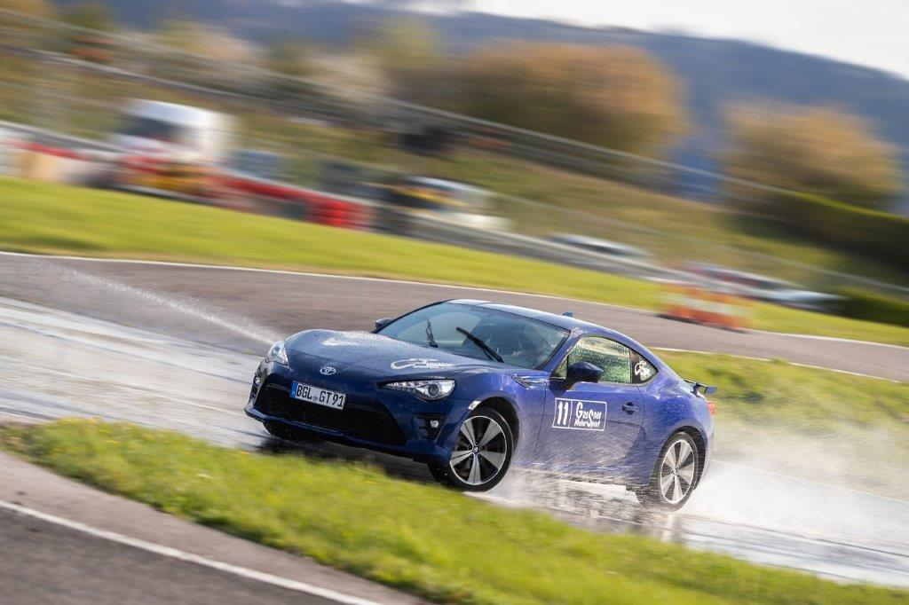
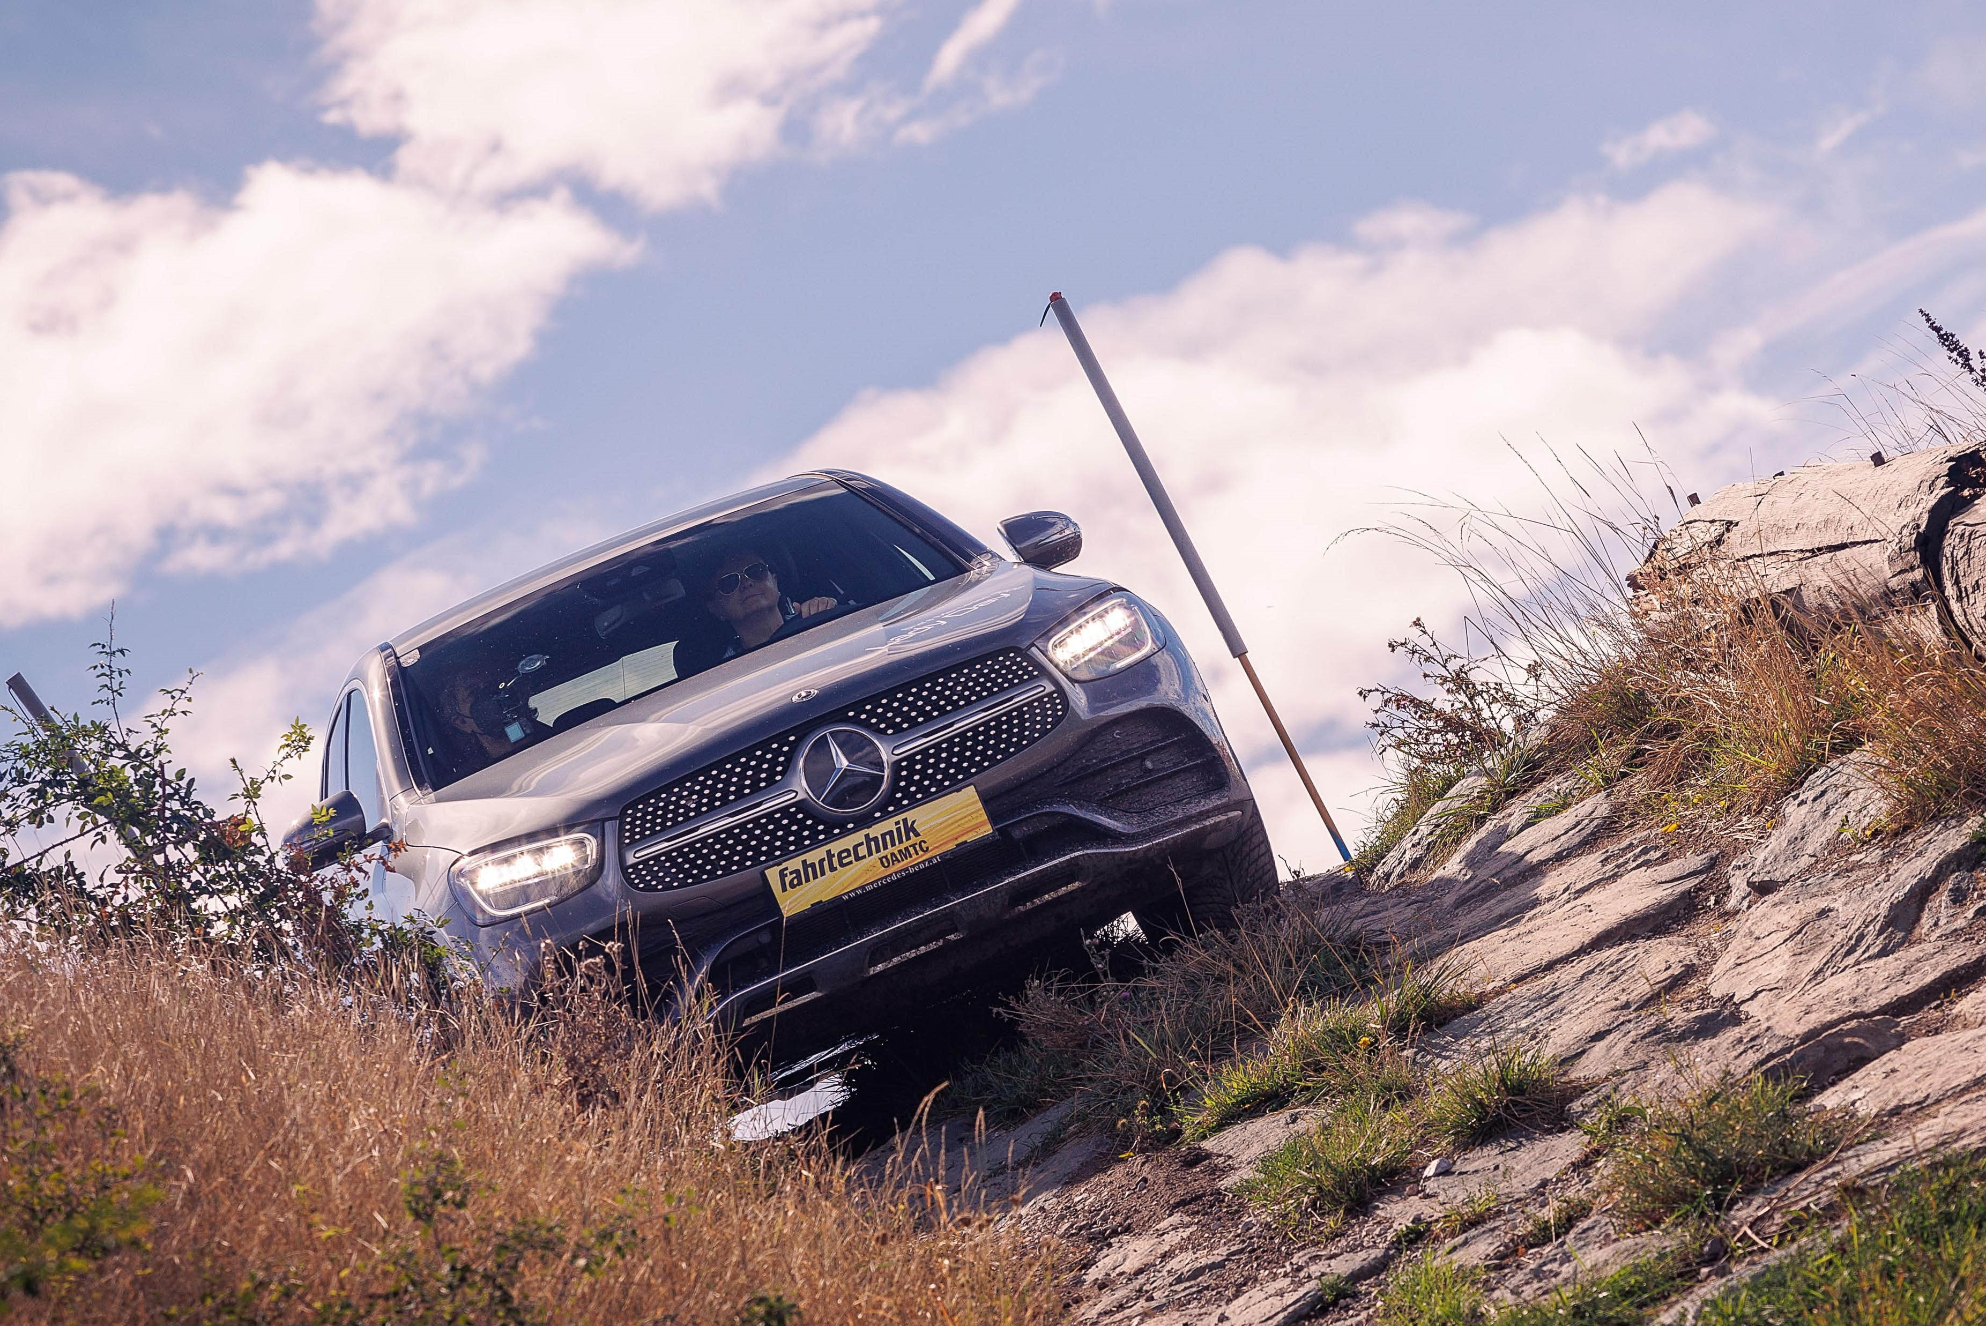
NO.1: BRAKING – AVOIDING OBSTACLES
NO.2: CAR CONTROL – SPIN PLATE
NO.3: TIME SLALOM - CURVE
NO.4: OFF ROAD – (OFF-ROAD TERRAIN)
NO.5: DAMAGE REDUCTION PARCOURS
NO.6: ROLL CAR
#6 TASKS

Slide 10
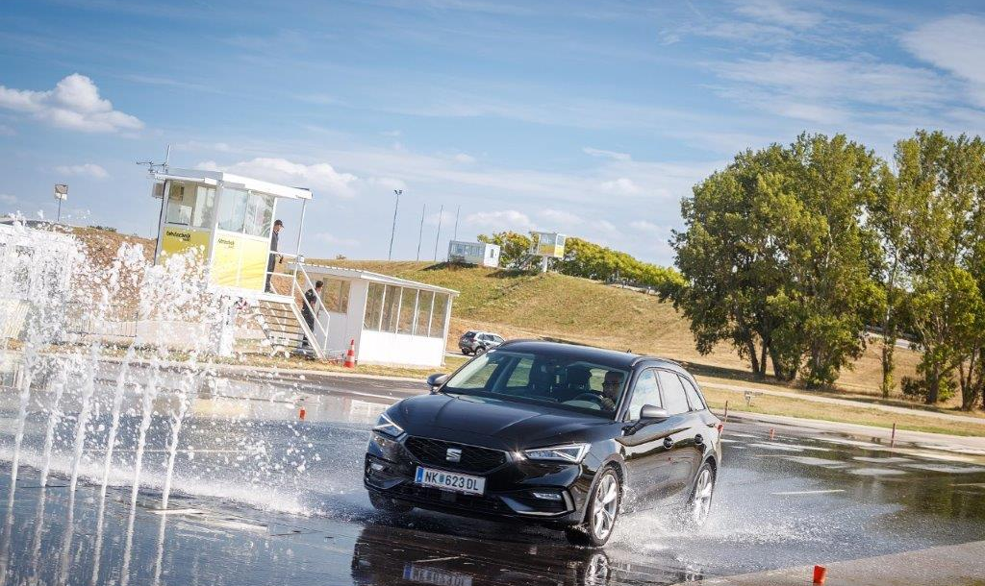
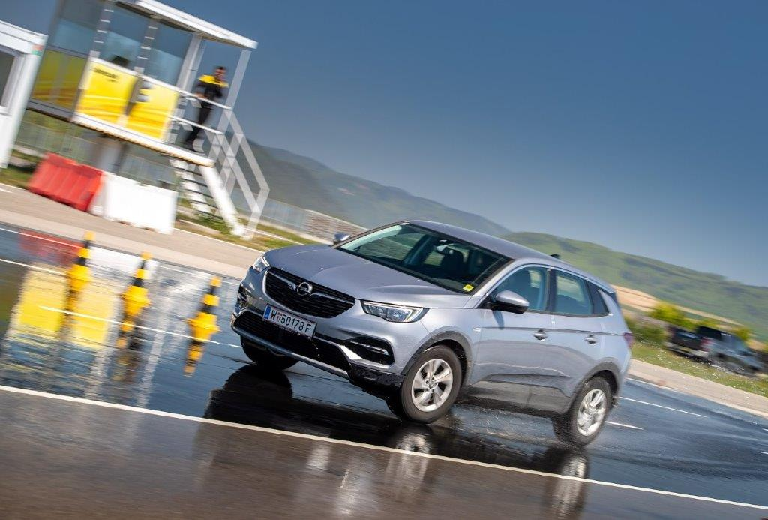
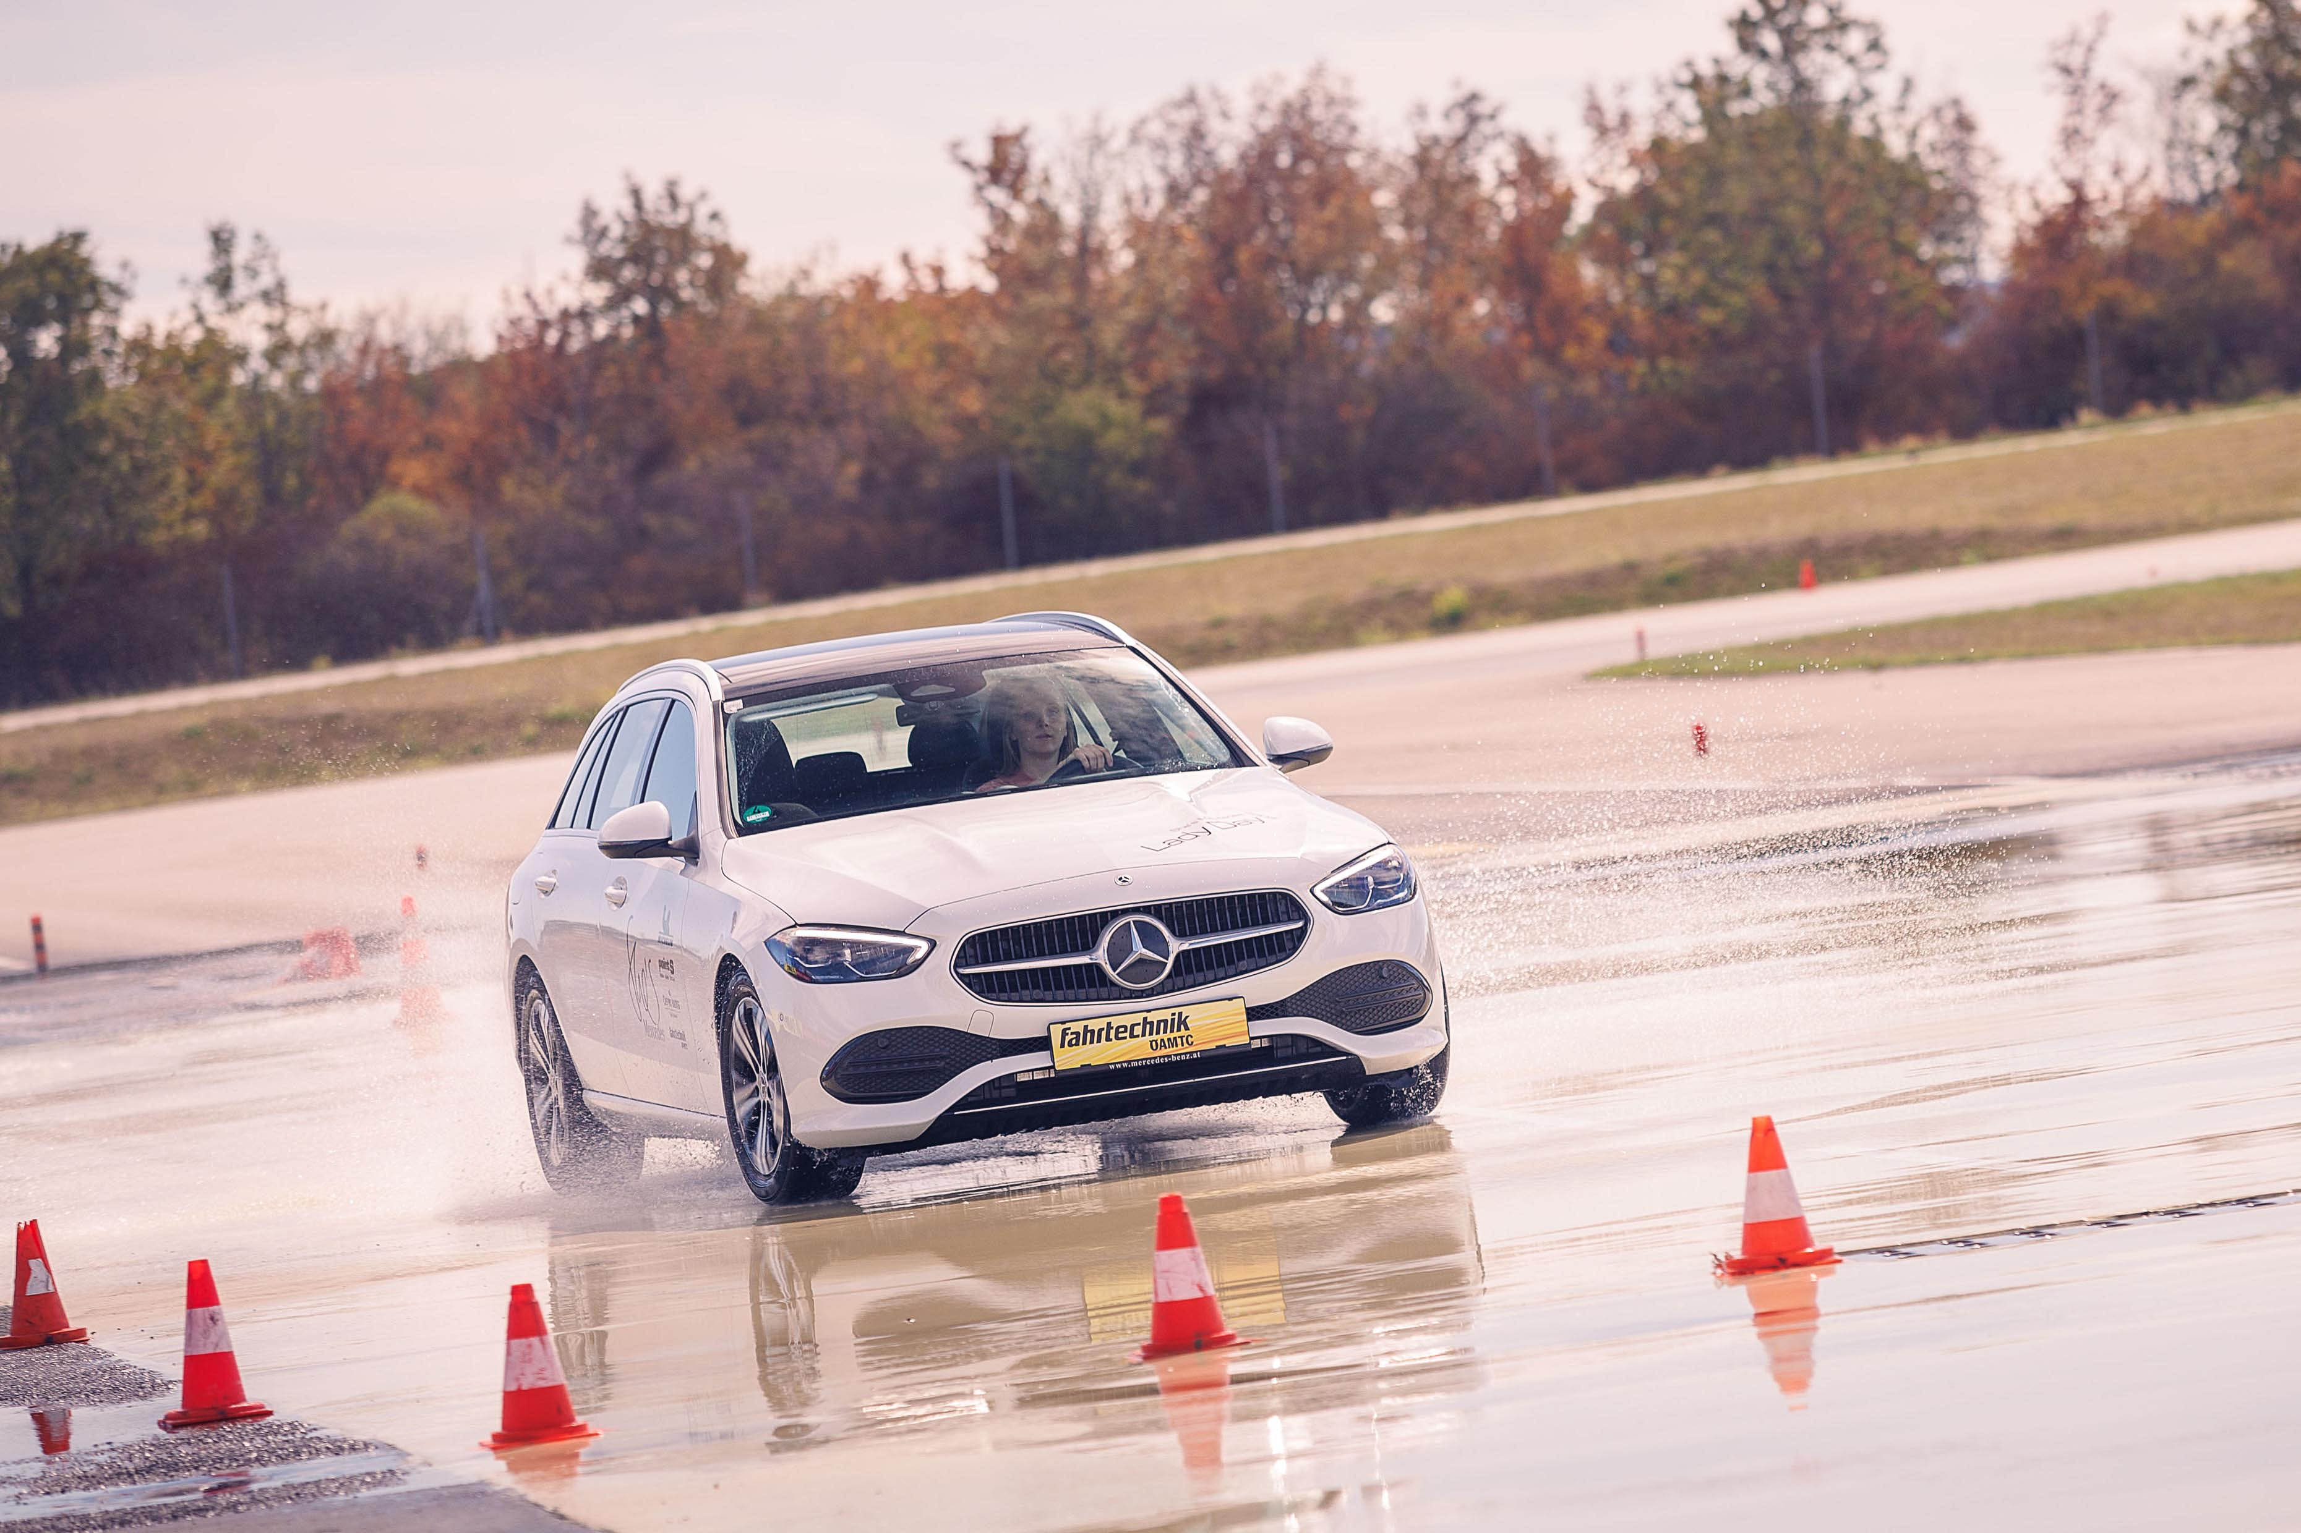
NO.1: BRAKING – AVOIDING OBSTACLES
DESCRIPTION:
Vehicle: 01 Vehicle: BYD Atto
The aim of the exercise is to drive a course on a slippery surface with a certain speed and not to hit any obstacles.
Surface: slippery surface
Speed is measured by mobile V-Measuring system.
Starting order will be drawn.
Seat belts must be worn.
Speed:
Minimum speed of 45 kmh (28 mph)
Top speed of 60 kmh (37 mph)
Penalties:
Cone contact - 05 km/h
Underspeed (less than 45 km/h) - 10 km/h
Overspeed (over 60 km/h) - 20 km/h
Leaving the track* - 20 km/h
* “leaving the track" means as soon as a tyre leaves the slippery surface.
Score:
The result is based on the driven speed minus any possible penalties in kmh. For example, if the driven speed is 50kmh and 2 cones are hit, the result is: 50 – 5 – 5 = 40 points.
#7 TASKS

Slide 11
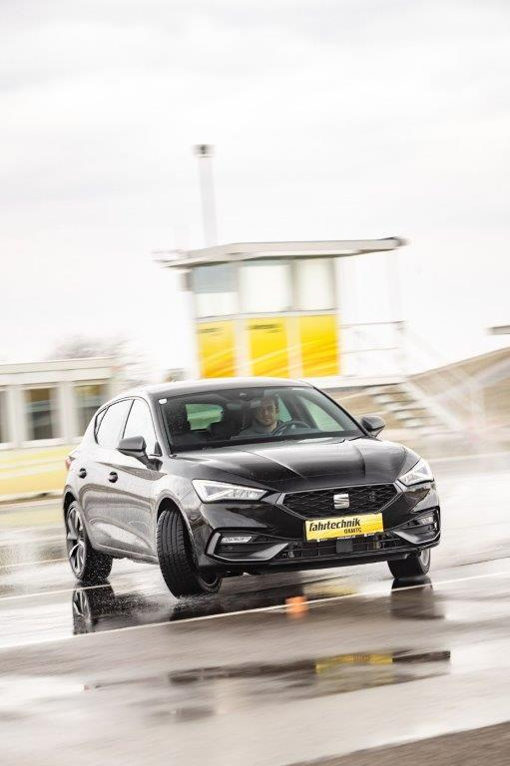
NO.2: CAR CONTROL – SPIN PLATE
DESCRIPTION:
Vehicle: 01 Vehicle: Cupra Formentor
The aim of the exercise is to bring a vehicle back into a stable driving condition between 45 and 60 kmh after the rear loses grip.
Surface: slippery surface
Starting order will be drawn.
Seat belt must be worn.
Speed:
Minimum speed of 45 kmh (28 mph)
Top speed of 60 kmh (37 mph)
Penalties:
Cone contact - 05 km/h
Underspeed (less than 45 km/h) - 10 km/h
Overspeed (over 60 km/h) - 20 km/h
Spin - 20 km/h
Leaving the Track - 20 km/h
Score:
The result is based on the driven speed minus any possible penalties in kmh. For example, if the driven speed is 50kmh and 2 cones are hit, the result is: 50 – 5 – 5 = 40 points.
#6 TASKS

Slide 12
NO.3: TIME SLALOM - CURVE
DESCRIPTION:
Vehicle: 01 Vehicle: BYD Han
The aim of the exercise is to complete a course as quickly as possible, and to make as few mistakes as possible.
Surface: slippery, wet and dry tarmac surface
Starting order will be drawn.
After the practice run it is a flying start. This will be demonstrated.
Seat belts must be worn.
Penalties:
Cone contact + 03 sec
Missing a gate + 06 sec
Not stopping (overbraking) in the target garage + 06 sec
Leaving the tarmac + 06 sec
Score:
The result is based on the fastest time then added penalty seconds. Time + penalty seconds.
For example, if the competitor completes the course in 36,45 sec but misses one gate, the result is: 36,45 + 6 = 42,45 sec.
#7 TASKS

Slide 13
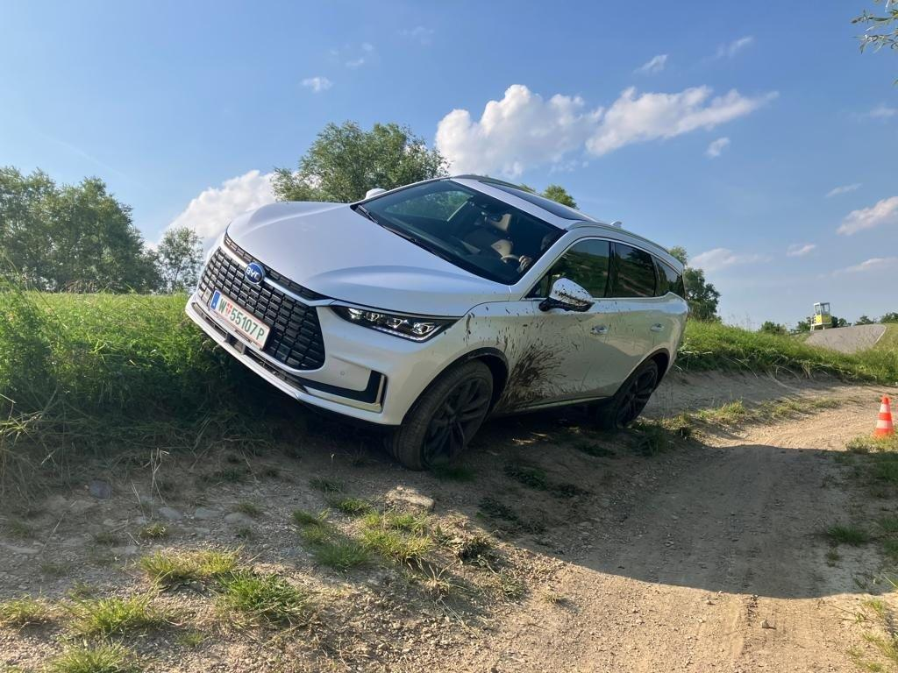
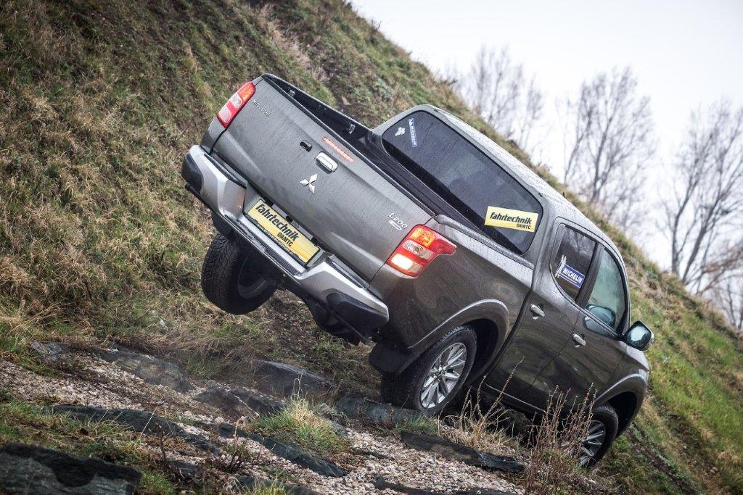
NO.4: OFF ROAD – (OFF-ROAD TERRAIN)
DESCRIPTION:
Vehicle: 02 vehicles: identical Ford Ranger with identical tyres
The aim of the exercise is to complete a marked course as error free as possible under a maximum time.
Surface: gravel and tracks
The marking is based on penalty points (0 penalty points best possible rating) and a measured time. Maximum time = 5 mins.
Starting order will be drawn.
Standing start (gate)
Finish in garage (target garage).
2nd competition vehicle can start, if the 1st still on track, if both participant and the instructor agree.
If two competitors have the same penalty points, then the best time counts.
Seat belt must be worn.
Penalties:
Wheels stopped 01 penalty point
Reversing (incl. stopping) 03 penalty points
Indicator falls (ball) or touches pole 06 penalty points
Leaving the imaginary line with all wheels (missing the gate) 06 penalty points
Exceeding the maximum time 10 penalty points
Score:
If the wheels stop twice and one indicator falls, the penalties are:
01 + 01 + 06 = 08 penalty points.
#7 TASKS

Slide 14
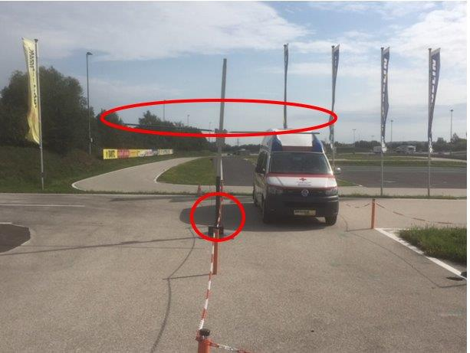
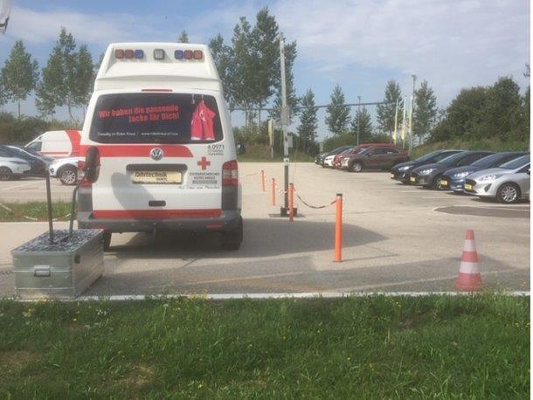
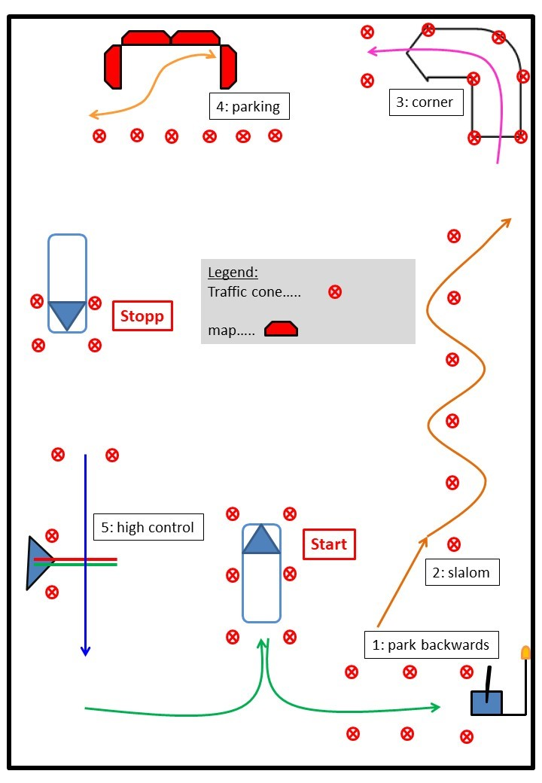
NO.5: DAMAGE REDUCTION PARCOURS
DESCRIPTION:
Vehicle: 01 Vehicle: Ford Custom
The aim of the exercise is a flawless drive through a very narrow course including some parking manoeuvres, making as few mistakes as possible.
Surface: tarmac
Starting order will be drawn.
Standing start.
Seat belt must be worn.
Penalties:
Reversing siren + 10 sec
Cone contact + 03 sec
Maps / barrier by parking + 10 sec
Not stopping (overbraking) in the target garage + 10 sec
Altitude control:
Green marker and red marker to high + 20 sec
Green marker ok – red not touched > perfect + 00 sec
Green marker and red marker touched + 20 sec
Score:
The scoring is based on the fastest time then added penalty seconds. Time + penalty seconds + estimation of the height of the vehicle.
For example, if the competitor completes the course in 52,78 sec but hit 2 cones and doesn’t stop in the target garage AND touch the green and red marker, the result is:
52,78 sec + 06 + 10 + 20 = 88,78 sec.
#7 TASKS
Notes:
14

Slide 15
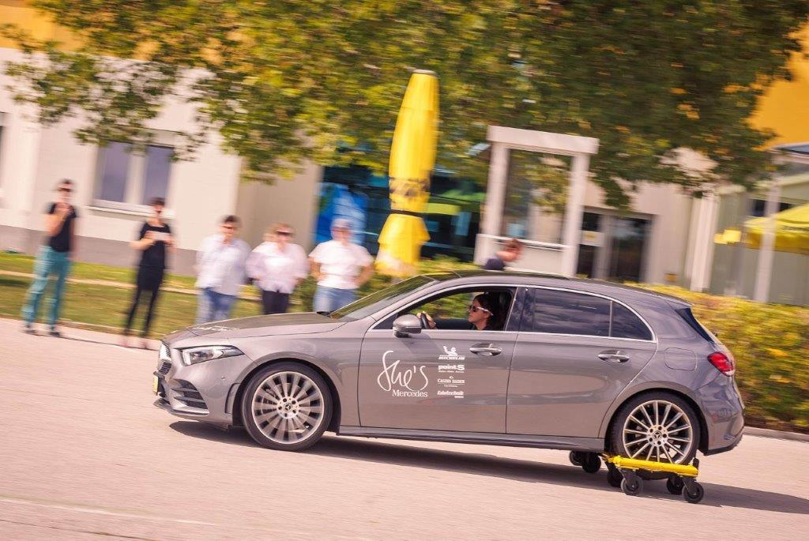
NO.6: ROLL CAR
DESCRIPTION:
Vehicle: 01 Vehicle: Kia eNiro
The aim of the exercise is to drive a giant slalom as error free, and as quickly as possible, with a vehicle with unstable rear wheels.
Surface: tarmac.
Starting order will be drawn.
Flying start, finish is stopping in a garage.
Seat belt must be worn.
Penalties:
Cone contact + 03 sec
Missing a gate + 06 sec
Not stopping (overbraking) in the target garage + 06 sec
Score:
The scoring is based on the fastest time then added penalty seconds. Time + penalty seconds.
For example, if the competitor completes the course in 27,76 sec, but hit a cone and miss one gate, the result is: 27,76 + 3 + 6 = 36,76 sec.
#7 TASKS
Notes:
15

Slide 16
TIME | TASK 1 | TASK 2 | TASK 3 | TASK 4 | TASK 5 | TASK 6
10.00 – 10.45 | GROUP 1 | GROUP 2 | GROUP 3 | GROUP 4 | GROUP 5 | GROUP 6
10.45 – 11.30 | GROUP 6 | GROUP 1 | GROUP 2 | GROUP 3 | GROUP 4 | GROUP 5
10.30 – 12.15 | GROUP 5 | GROUP 6 | GROUP 1 | GROUP 2 | GROUP 3 | GROUP 4
13.15 – 14.00 | GROUP 4 | GROUP 5 | GROUP 6 | GROUP 1 | GROUP 2 | GROUP 3
14.00 – 14.45 | GROUP 3 | GROUP 4 | GROUP 5 | GROUP 6 | GROUP 1 | GROUP 2
14.45 – 15.30 | GROUP 2 | GROUP 3 | GROUP 4 | GROUP 5 | GROUP 6 | GROUP 1
#8 TASK SCHEDULE
*Any changes in the task schedule will be communicated timely during the briefing on Friday, 6.10.2023

Slide 17
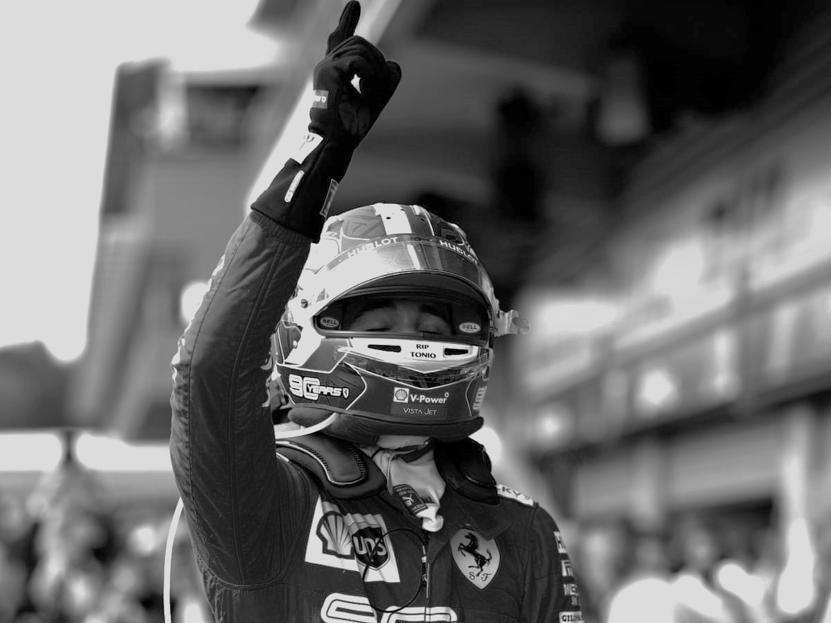
#7 WINNER PRIZE
WINNERS 2023
2 PASS FOR FORMULA 1
IN 2024
Travel costs covered by FIA RI

Slide 18



CONTACT
DETAILS
ÖAMTC – FINAL RESPONSIBLES
Eva Maria Kerschl eva-maria.kerschl@oeamtc.at +43 1 71199 21231
Ernest Loidl ernest.loidl@oeamtc.at +43 664 613 2108
FIA REGION I – MEMBERSHIP AND EVENT MANAGER
Ha Phan haphan@fia.com +32 478 088 066

